Slide 1
The Mobile Alabama Cruise Terminal and City of Mobile

Slide 2
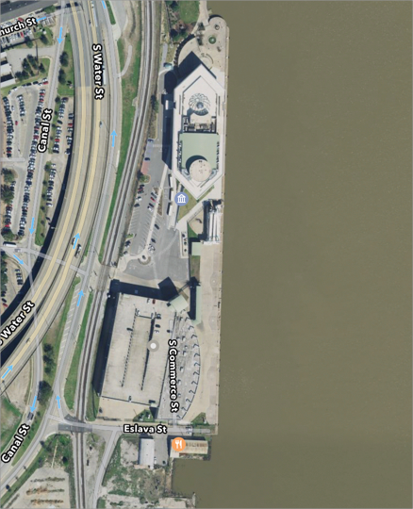
City of Mobile Alabama Cruise Terminal
201 South Water Street
Mobile, AL 36602
Phone: (251) 338-7447 POC: Sheila Gurganus
GulfQuest Maritime Museum
Mobile Alabama Cruise Terminal
100 ton mooring bollards, 60 ft spacing
Trellex fenders, 60 ft spacing
1,200 ft dock
Large turning basin south of terminal accommodates ships >1100’
Pilots backing into and out of berth from turning basin
Water depth 30 ft MLLW pierside
Dock elevation +8.0 ft
Dock height above MHW +7.0 ft
Dock height above MLLW +8.5 ft
Fresh water available

Slide 3
Cruise Terminal just a 3.5 hour transit from the sea buoy
Passenger ships receive first priority for transits
45’ Channel Project Depth

Slide 4
Much to See and Much To Do
USS Alabama
One of Alabama’s most popular attractions
Bellingrath Gardens
World class botanical gardens
Wild Native Delta Safari
Eco-tour into America’s Amazon, The Mobile-Tensaw River Delta
Gulf Coast Ducks
Mobile’s exciting Duck Boat Tour of Mobile River and downtown
Gulf Coast Exploreum
IMAX theatre walking distance from terminal
Downtown Restaurants and Culinary

Slide 5
Much to See and Much To Do
Museums
GulfQuest Maritime Museum of the Gulf of Mexico (next to Terminal)
History Museum of Mobile
Mobile Museum of Art
Mobile Medical Museum
National African American Archives and Museum
Mobile Carnival Museum

Slide 6
Mardi Gras
The Mobile Alabama Cruise Terminal is typically available for Port of Calls on Sunday, Monday, and Mardi Gras Tuesday
Passengers can experience day or evening Mardi Gras parades and the Mobile Mardi Gras experience is within easy walking distance of the terminal

Slide 7
For More Information
Patrick Brennan
Waterfront Coordinator
586-322-9819 (cell)
Patty Kieffer
Director of Leisure and Sales, Visit Mobile
pkieffer@mobile.org
251-208-2012 (office)

